Slide 1
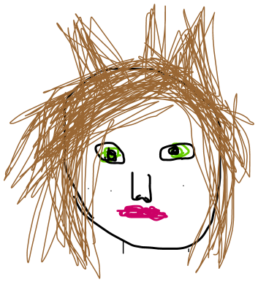
Needs: A source of news that can also be relaxing and funny Obstacles: Strict work ethic leaves little time for relaxation Accessibility: Site needs to have relevant information displayed quickly and clearly so that Jasmine can quickly view what she wants to on the site.
Name: Jasmine
Role: Journalist/Analyst
Personality Traits:
Inquisitive
Focused
Has a sense of humour
Ideals:
Likes to present information to the public
- Believes in a good work ethic
- Understands that relaxation is required to break stretches of work
Other:
Can be abrupt sometimes
Can find humour in places others can’t.

Slide 2
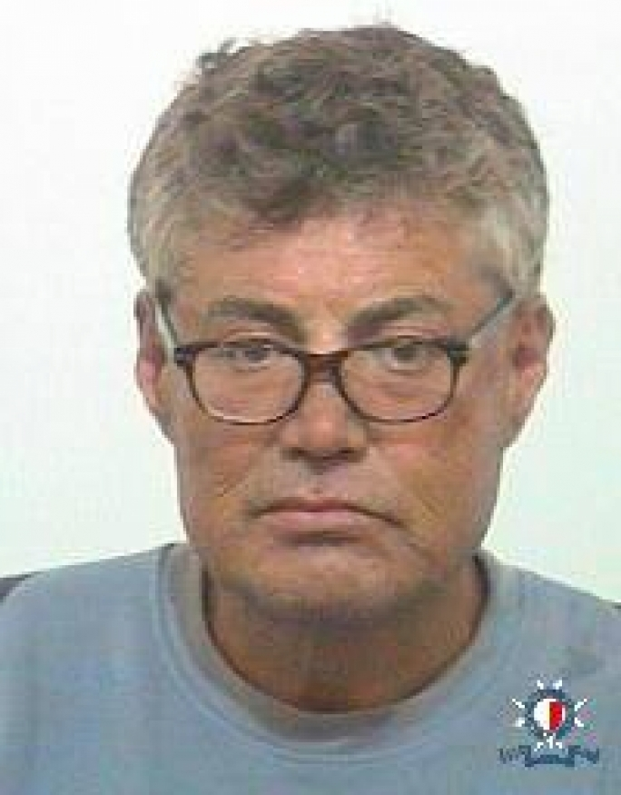
Samuel Cynical older man retired and looking for stuff to do
“Selfish and petty squabbles no longer require my time.”
In need of new hobbies
Highly experienced in law
Strong personality
Personal Profile
Samuel has worked as a lawyer for many years and spent a good portion of that time seeing pitiful squabbles and ridiculous family infighting over wills and inheritance. Frankly, he had seen enough and having saved plenty of money, decided to get an early retirement.
He had never really had the time or motivation to start a family of his own and now finds himself a bit lost. Many of his old hobbies have started to grow stale after his new period of work inactivity and he has decided to look to the internet for new sources of entertainment and engagement.
Sites with unorthodox humor and usage of irony really speak to Samuel and he finds himself a regular visitor of sites that employ such tactics.
Personal Information
Profession: Lawyer (Retired)
Location: Longueville, NSW
Age: 54
Hobbies: Reading, model plane flying, trying out new restaurants.
Favorite TV Show: N/A
Personality: Reserved but strong-willed, self-oriented
Internet usage
Internet experience: Intermediate
Primary Uses: E-books, emails, entertainment
Favourite Sites: Booktopia, TheOnion
Hours online per week: 14
Computer: Asus 14” laptop with wireless keyboard mouse.
Study information
Current qualifications: Law graduate, Experienced lawyer (25+ years)
Literacy: Very high
IT Skills/knowledge: Intermediate, good critical analysis skills.
User Goals Samuel visits The Onion to… See news and current affairs in a humorous fashion. Find a bit of a laugh in his mundane days of retirement. Engage with other users of similar mindsets in the comments. | Business Objectives We want Samuel to… Regularly visit the site for ad revenue Engage with the user community Speak to acquaintances about his experience on the site. Subscribe to our premium services Offer feedback on the user experience

Slide 3
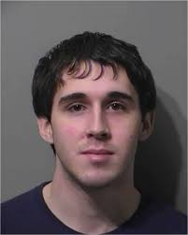
Charles University student with some time to kill
“Work hard… then stuff around”
Student of Engineering
High internet competency
Hard worker
Personal Profile
Charles is a young adult who is currently studying engineering at the University of New South Wales. He lives in a dorm with several other students as his family living in South Australia thought it would be good for him to have some experience away from home.
He is quite studious and often finds himself without much to do after completing any required work. This is when he occupies his time with one of his hobbies, such as gaming, playing soccer, or browsing the internet. Often this will result in him finding an interesting previously unheard-of website.
He will then use this as a point of conversation when speaking with friends or acquaintances.
Personal Information
Profession: Student of Engineering (UNSW)
Location: UNSW dorm, NSW
Age: 20
Hobbies: games, soccer, internet browsing
Favorite TV Show: Black Mirror
Personality: Studious, perfectionist, competitive
Internet usage
Internet experience: Extensive
Primary Uses: Uni work, online games, social media
Favourite Sites:
Hours online per week: 30
Computer: Custom Desktop, gaming peripherals
Study information
Current qualifications: Enginerring student
Literacy: Substantial
IT Skills/knowledge: High – Very High
User Goals Charles visits The Onion to… Alleviate boredom Discover interesting conversation topics Find some general news information with a satirical twist Take a minor break between study sessions | Business Objectives We want Charles to… Visit the site repeatedly for ad revenue Engage with the articles Subscribe to our premium services Speak about the site to his friends and acquaintances Publish comments and feedback on the site

